Slide 1
Linear Regression K – nearest neighbours
Set up T4 Machine – 15 min
Progress check – 5 min
Linear Equation and Cost function
Gradient Descent
R-square
Assumptions
Assignment – 5 min
Notes:
If finding hard to learn concepts, complete all exercises in book Learning Python 3 hard way
https://mubaris.com/posts/linear-regression/

Slide 2
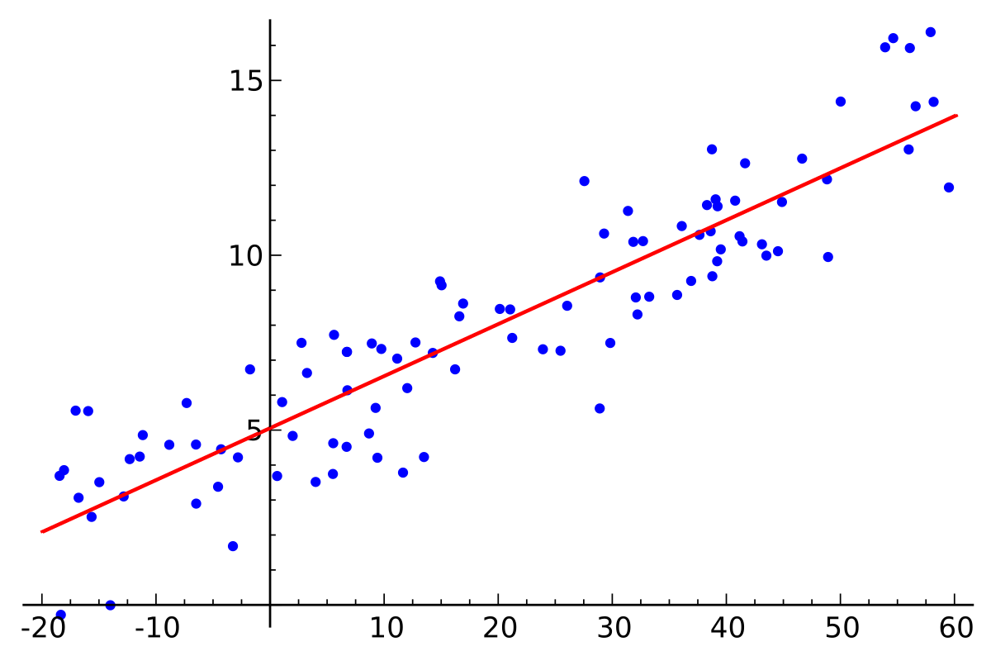
What is Linear Regression
To find the best fit straight line

Slide 3
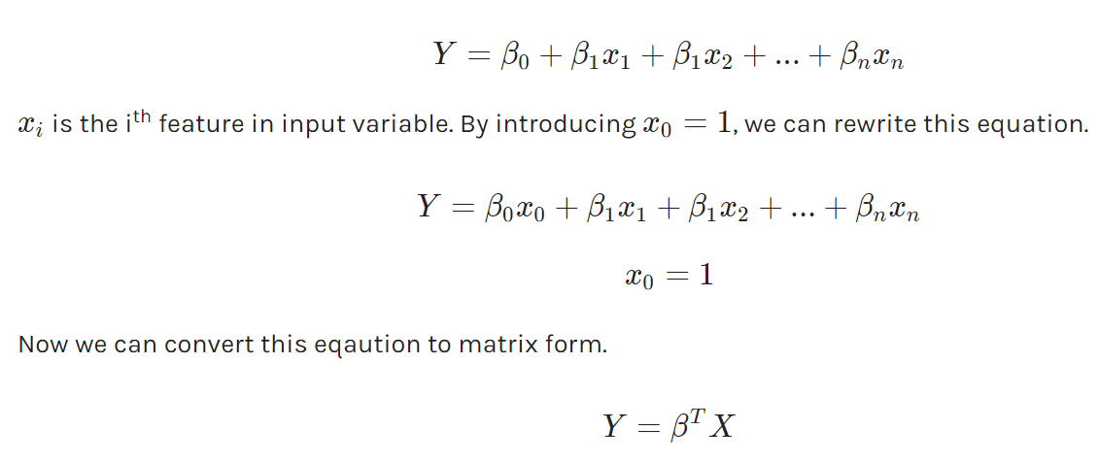
Linear Equation

Slide 4
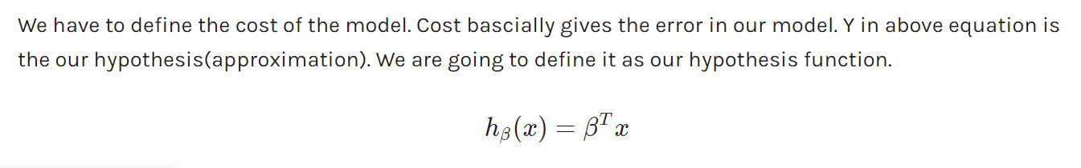
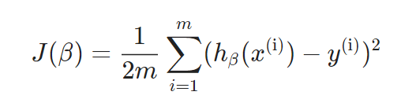
Cost function To find out the best possible value of a (Intercept) and b (Slope)
Mean Squared Error function

Slide 5
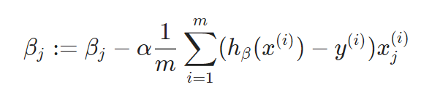
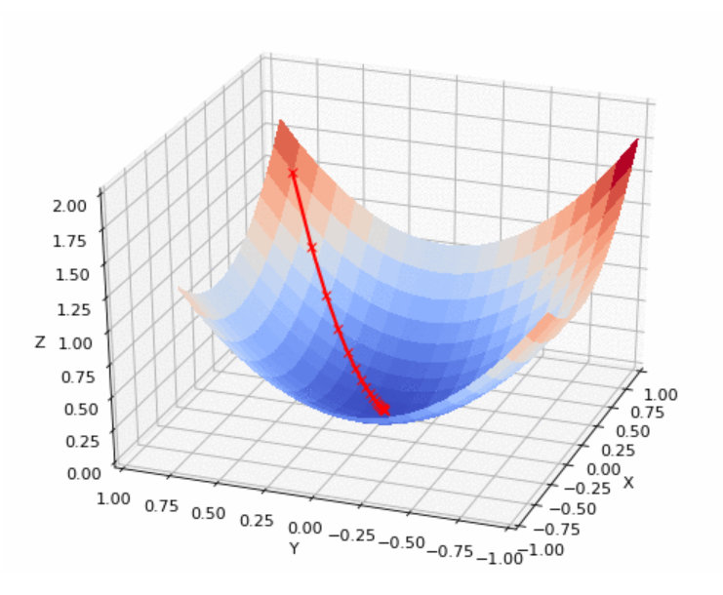
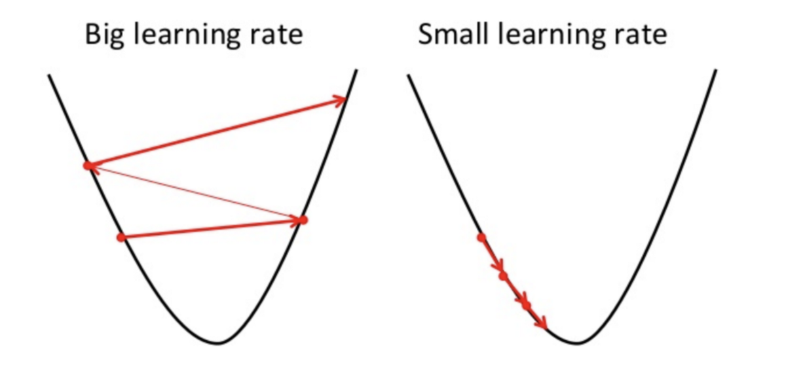
Gradient Descent
Iteratively update Bj

Slide 6
Assumptions
Linear relationship
Multivariate normality
No or little multicollinearity
No auto-correlation
Homoscedasticity

Slide 7
Assignment – Due by 27th May
1. Find out the various checks to test the assumptions of linear model and apply on Electricity_Linear data
2. Find out the best fit linear model to Predict electricity output. Use 5 fold cross validation to validate your results.
An engineer at a power generation plant anticipates that power generated in the plant can be calculated only from ambient variables of the plant i.e. without knowledge of the machines and their efficiencies. He has data of ambient variables and electricity generated for several days, so to check if his anticipations are correct he asks you to predict Net daily generated electrical energy (E) MW for 200 days.
The ambient variables of the power plant are:
Temperature (T) in °C
Ambient Pressure (P) in millibar
Relative Humidity (RH)
Exhaust Vacuum (V) in cm Hg
The training data includes ambient variables along with Net daily electrical energy (E) MW.
The variables are given without normalization.

